Slide 1
Public records primer: federal edition
Sarah Cohen, for Columbia University
February 2014

Slide 2

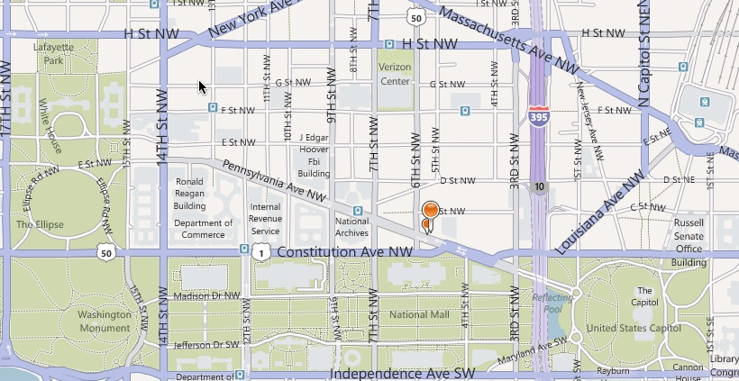
Congress shall make no law … abridging the freedom of speech, or of the press….

Slide 3
“The basic purpose of FOIA is to ensure an informed citizenry, vital to the functioning of democratic society, needed to check against corruption and to hold the governors accountable to the governed,”
- Supreme Court of the United States, NLRB v. Robbins Tire Co., 1978
“A democracy requires accountability, and accountability requires transparency,”
- President Barack Obama, Jan. 21, 2009

Slide 4
What is FOIA?
FOIA IS:
A law created to ensure access to documents and other artifacts created and held by government agencies
A formal process to obtain records
FOIA IS NOT:
An efficient process
A well understood or consistently administered law
The right to “information.” It only gives you the right to records that already exist, not to questions you might have.

Slide 5
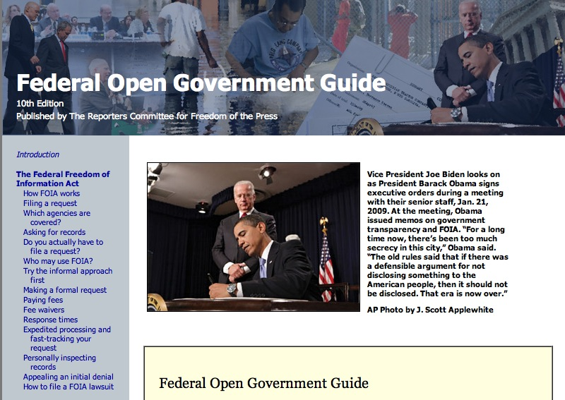
Reporters’ Committee for the Freedom of the Press: best guide to federal FOIA and help for reporters
Notes:
Get the basics of what you can and can’t get from RCFP. Look especially at a few exemptions of interest to reporters in the security realm:

Slide 6
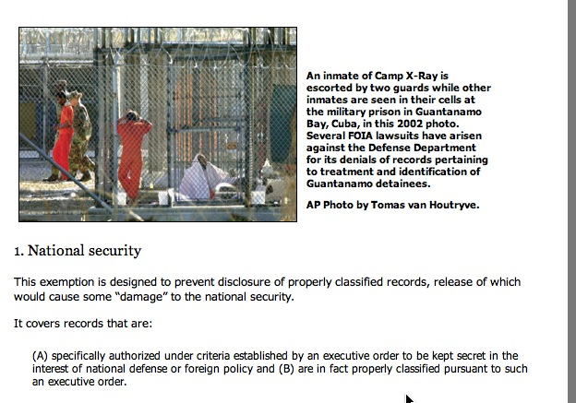
FOIA exemptions: what’s secret
FOIA says records must be released…. except when they’re not.

Slide 7
Other exemptions
Exemption 4: Trade secrets come into play in contracts and their associated records.
Exemption 5: Internal agency memos are up to each administration to decide.
Exemption 6: “Personnel and medical files and similar files the disclosure of which would constitute a clearly unwarranted invasion of personal privacy.”
Exemption 7(c): Similar wording, this time for law enforcement and and investigative records.

Slide 8
Common federal records
Agency “control correspondence,” or records of Congressional office communication with agencies. This is the only way to get records of Congress.
Schedules and calendars of high-level government officials.
Contract payments and some contract language.
Grant payments, audits and reports.
Names, positions and pay records of agency personnel
Comments made by lobbyists and others on agency activities
Operating manuals, directives to employees and other official procedures.
FOIA logs (requests made by others)

Slide 9
Finding records
Actors in the process
Inspector general, auditor reports methodology section
Inventories of record collections
Blank forms (online and on paper)
Case management and tracking systems
Take a tour – virtual or in-person, including FOIA site
Regulations, the law
Statistical reports (sources)
Look for outside sources of the same thing – other agencies, state and local records.
Notes:
Figuring out what to look for is the most difficult part of the process. Here are some examples from DOD programs. When interviewing people, always ask for the title of the record or the name of the form, ask them to look at it closely or get a copy of it. You need to know what to ask for.

Slide 10
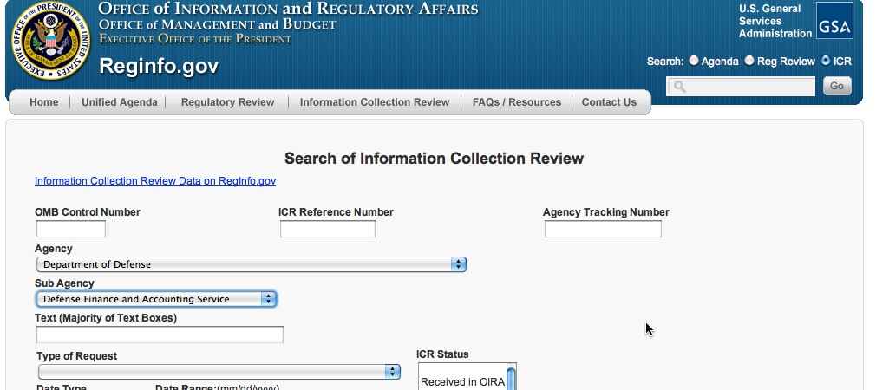
Reginfo.gov is the site used by the Office of Management and Budget to store its reviews under Paperwork Reduction Act. All information collections (most forms, databases) must be logged here.
Notes:
Finding forms

Slide 11
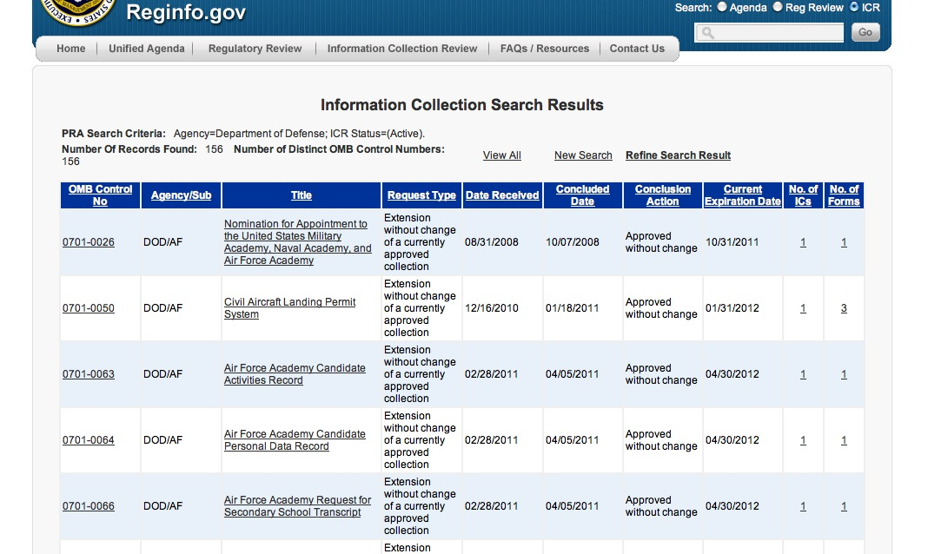
Notes:
Look for interesting ones by agency

Slide 12
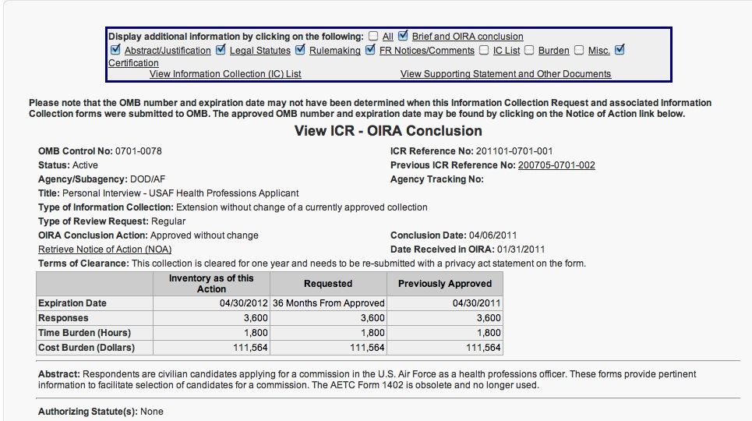
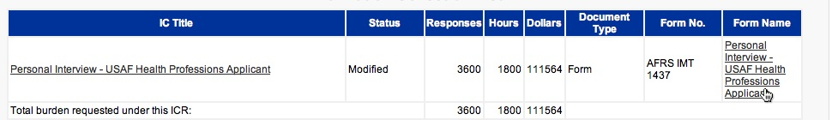
Notes:
Then click on the “view information collection” to see a copy of the form. If there isn’t one, it will instead often give you the form number you need to google.

Slide 13
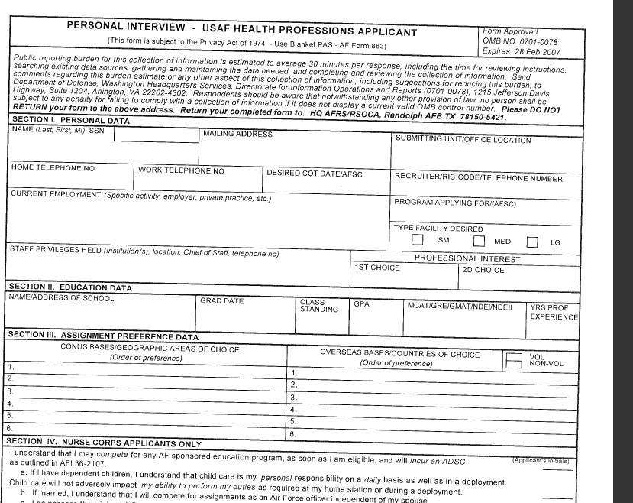
Notes:
Now you know what’s collected during each interview.

Slide 14
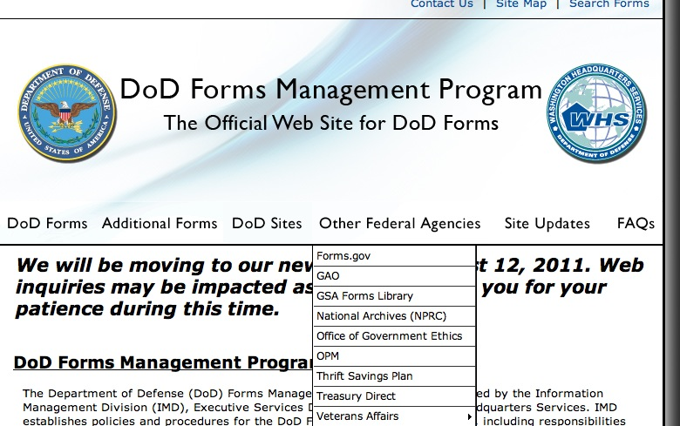
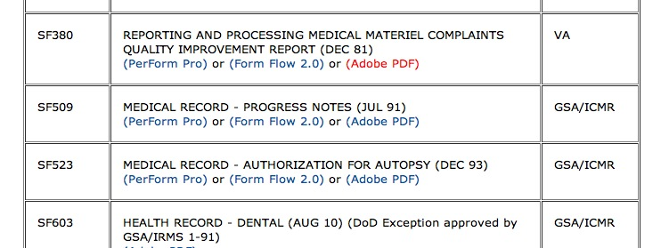
Notes:
Some agencies have forms management sections. Look through them. Here’s one: medical materiel complaints.. It gives you the basics of what you can ask for.

Slide 15
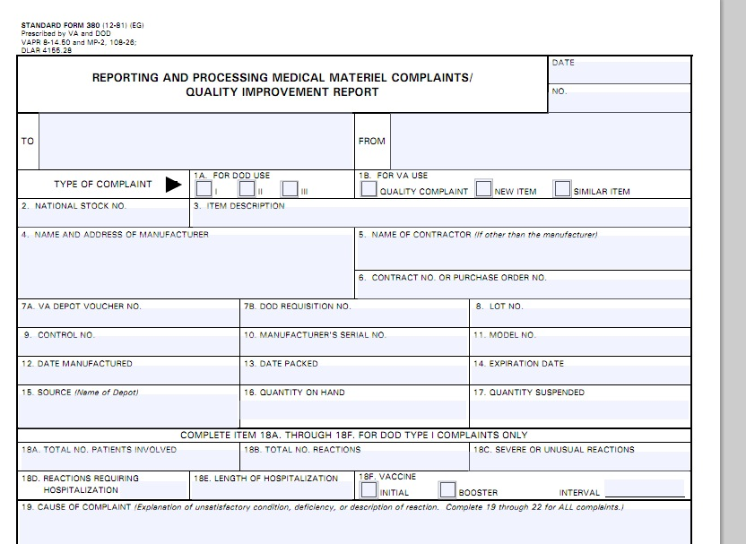
Notes:
The best ones will also have instructions with them, allowing you to see where it gets filed.

Slide 16
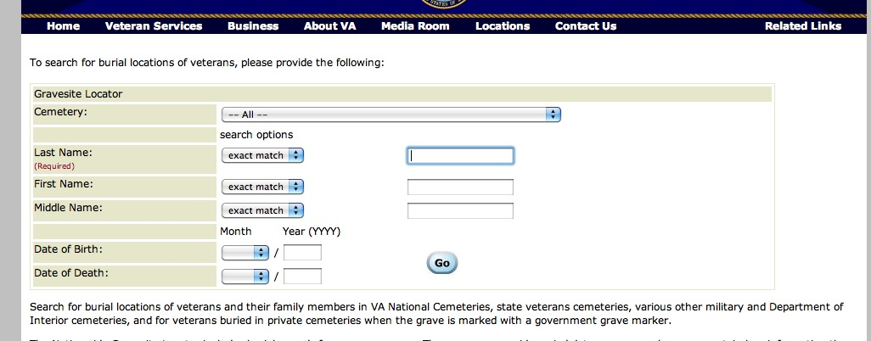
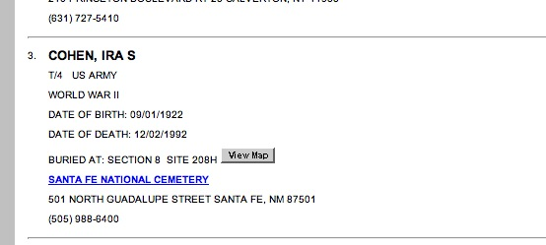
Notes:
Don’t forget online searches – these forms show you what the government has and what you can get without a FOIA. (My father’s record)

Slide 17
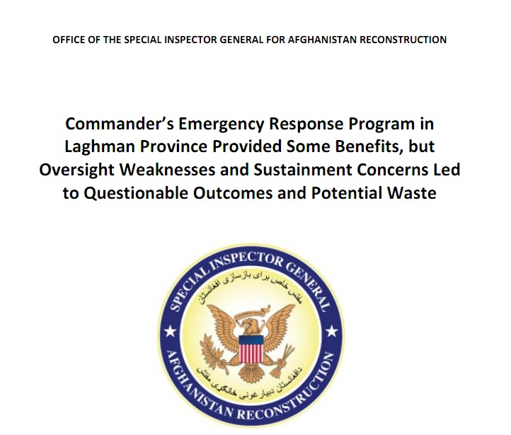
Read footnotes, methodology and all source notes to find the paper trail
Notes:
Inspector general, GAO, audit reports

Slide 18

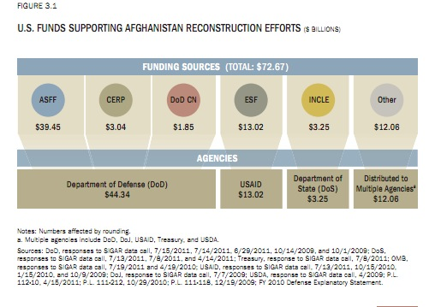
Notes:
This gives you the basics of where the money comes from and how SIGAR gets it.

Slide 19
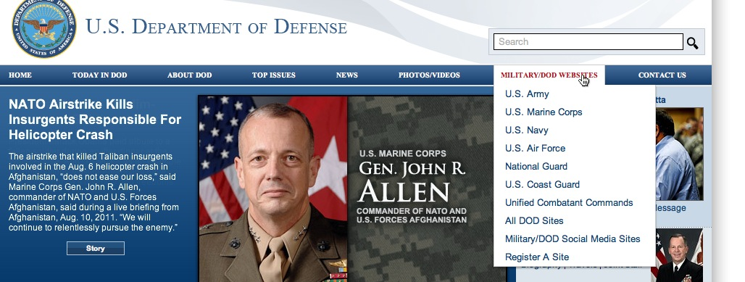
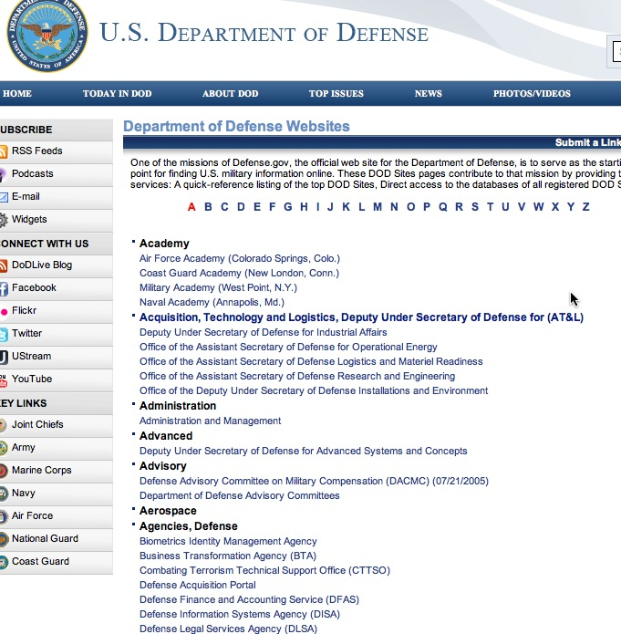
Notes:
Take a virtual tour. When you’re starting on a project or beat, do a good, disciplined review of the websites. Ignore anything that tries to push you into a role – instead, go right to any lists you can find.

Slide 20

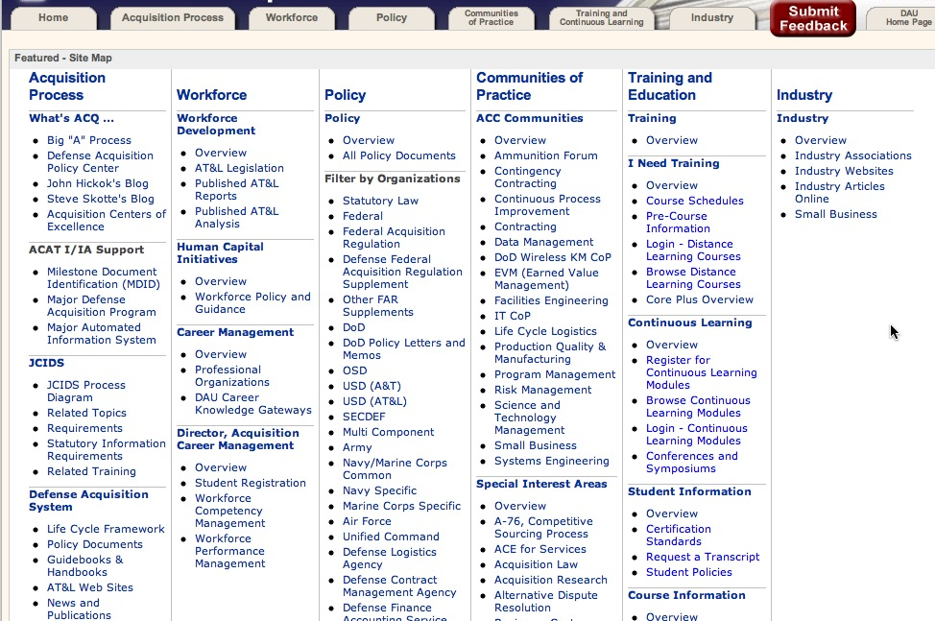
Look for site map
Notes:
Just reading a site map without clicking anywhere will tell you a lot about how the agency is organized and where you might look for documents or data. You probably won’t get that far, though – you’ll get interested in something you see. This is like a menu.

Slide 21
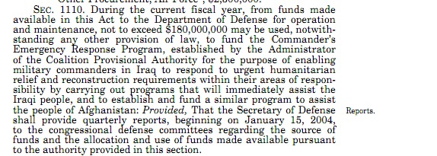
PL 108-106, Emergency Supplemental Appropriations
Notes:
When you know of a program, look for its authorizing and appropriations legislation for required reporting. Congress usually ignores these, but the agencies don’t.

Slide 22
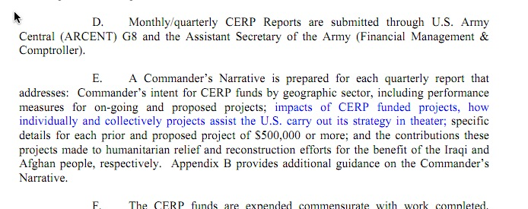
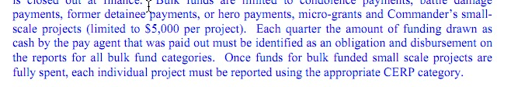
The regulations that implement the law often have even more specific reporting requirements, and who is responsible for them:

Slide 23
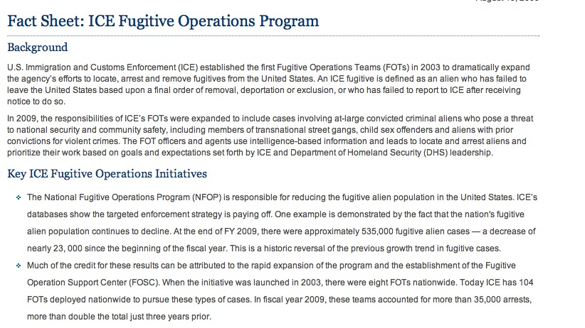
Notes:
Statistics have to come from somewhere – there is a name behind each of the 535,000 fugitive alien cases.

Slide 24
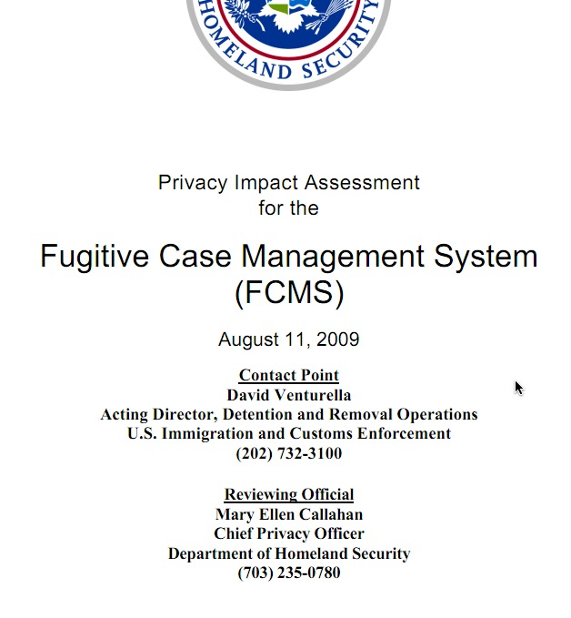

Slide 25
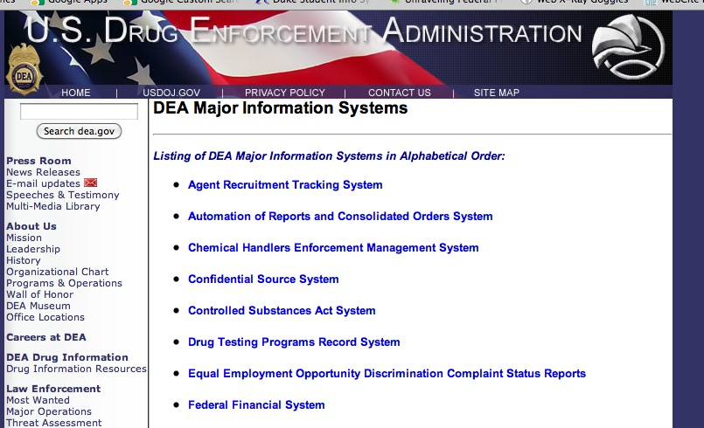
Notes:
Agencies are supposed to, by law, have a list of major information systems on the FOIA website. Most don’t.

Slide 26
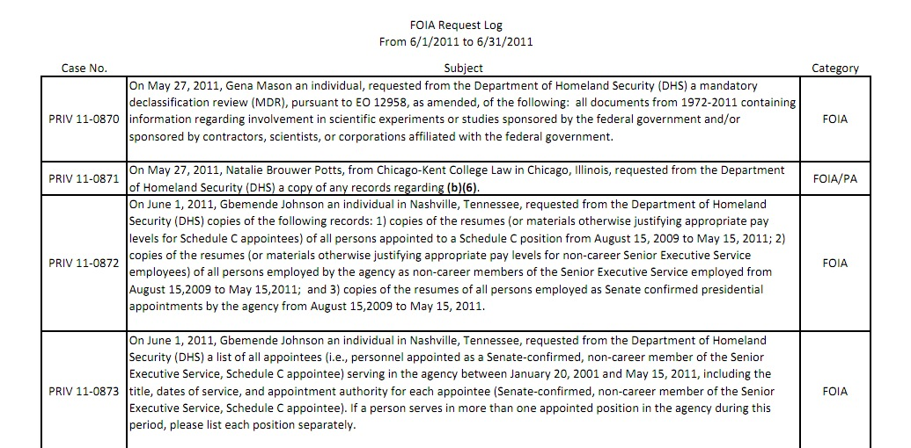
Notes:
More agencies are putting their FOIA logs and recently requested records online. Look at the bottom of ANY federal government website for FOIA or Freedom of Information

Slide 27
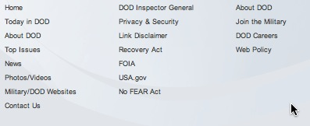
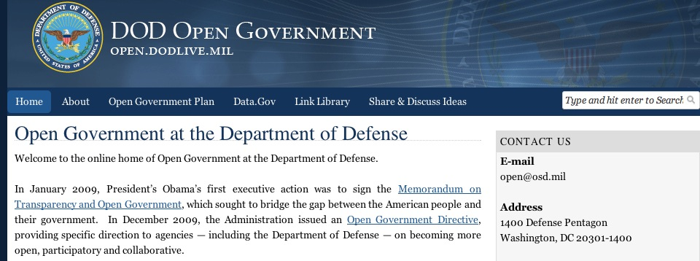
Notes:
Look for FOIA logs and recently requested records, and look separately at the Open Government portal. They have completely different things.

Slide 28
The Request
Too narrow?
Too broad?
Quote the law
Look for precedent on the records – avoid complaints in advance.
Don’t ask for anything you clearly aren’t allowed to get
Acknowledge things they might be able to release, ask anyway.
For databases, ask for more.
For documents, ask for less.
(more)

Slide 29
The request (con’t)
Eager to help refine the request
Appeal if possible
Ask for an index to the records, then you can pick the ones you want.
Ask for a copy of a similar one from the past
Get a copy from an interest group while your request is being processed.
Communicate.

